Slide 1
CP1 - Image Deblurring using Least Squares Approximation, QR Factorization, and Householder Reflectors
Reese Karo, William Mahnke, Raaghav Thatte

Slide 2
Overview
Goal: Blur an image using OpenCv, and Numpy, and then transform the image back to the original using various methods of least squares approximation

Slide 3
Concepts Used
Least Squares Approximation
QR Factorization
Householder Reflectors

Slide 4
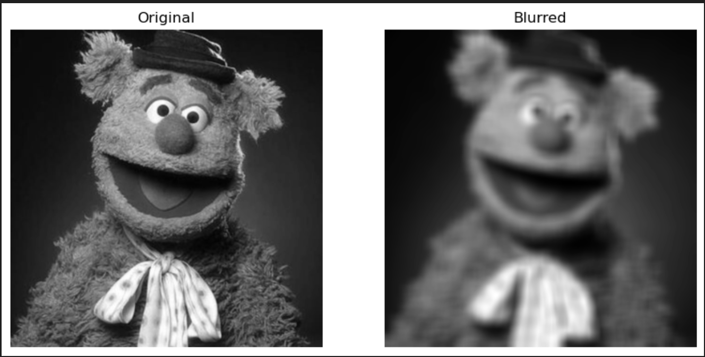
Method: Blurring the Image
Check that least squares is applicable
Fozzie Bear image is a 678 x 664 array → m > n, so we can use least squares
Convert image to black and white
Apply OpenCV’s cv.blur in python (here, blurring is set to (25, 25))

Slide 5
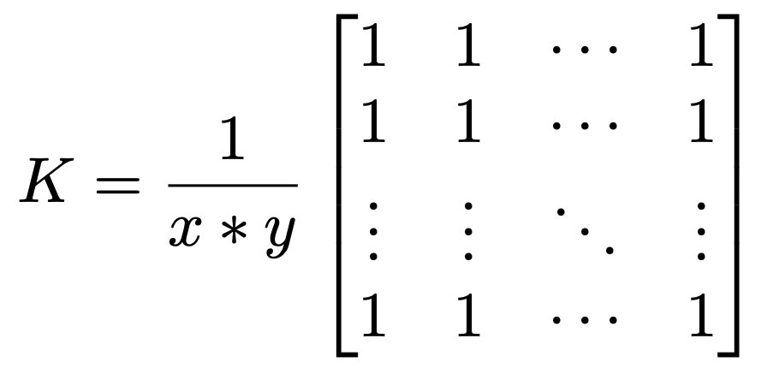
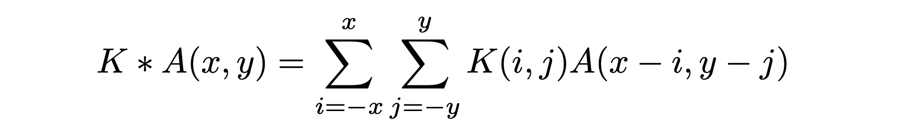
Blurring Effect (Smoothing):
The blurring effect comes from convolving our image matrix with a kernel K, which is know as a normalized box filter. K is defined as:
Matrix convolution of K and A is defined as:

Slide 6

Method: Applying Least Squares
Least Squares Approximation: Given an m x n matrix A and vector b of length m, we aim to solve the normal equation
Our “target” vector is the original image, which is an m x n array of values as opposed to a vector of length m.
In order to properly utilize least squares, we will iterate through the columns of the original image matrix to create each individual column of our solution matrix.
Our solution matrix is an n x n matrix.

Slide 7
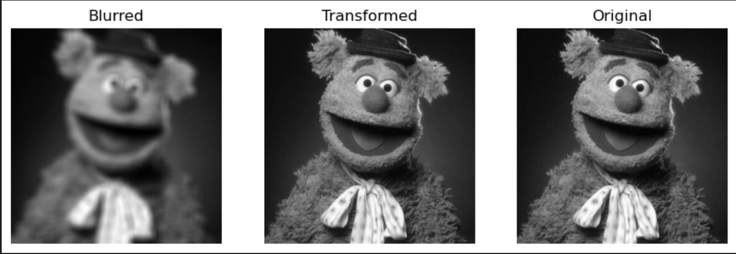
Method: Applying Least Squares
(via Numpy’s Least Squares function)
The resulting image is nearly identical, with very minor issues in shading.

Slide 8
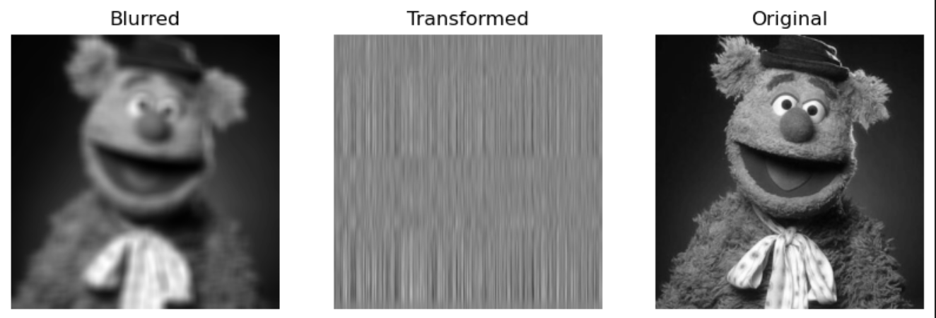
Method: Normal Equation
(via our own hard code)
Normal equation with the original blurring at (25, 25)

Slide 9
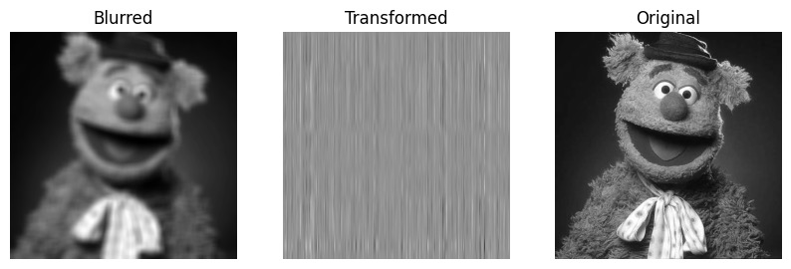
Method: Normal Equation
(via our own hard code)
The blurring in this case was set to (15, 15).

Slide 10
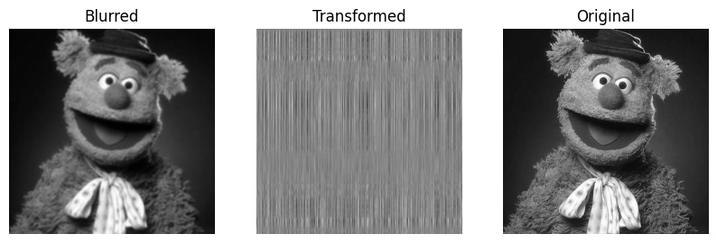
Method: Normal Equation
We then set the blurring on the original image to (5,5).
Clearly, the matrix is ill-conditioned, and the normal equation is NOT a suitable equation for this task.

Slide 11
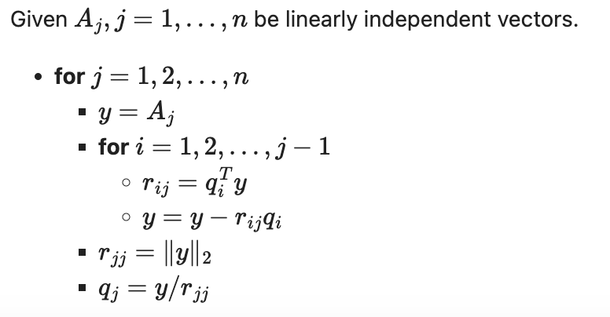
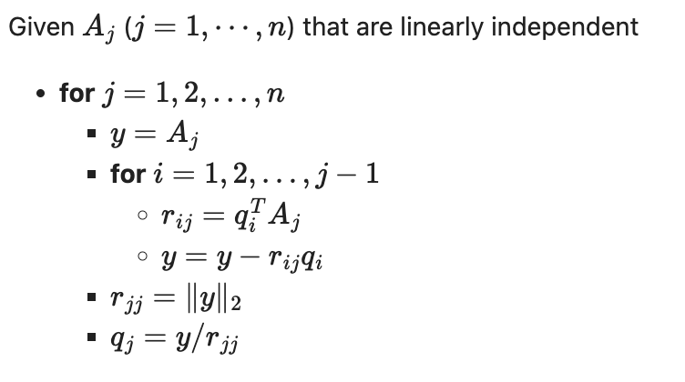
Method: QR Factorization
Modified Gram-Schmidt:
Gram-Schmidt:
QR factorization gives an orthogonal matrix Q and upper-triangular matrix R
Provides a more numerically stable way to compute systems of equations

Slide 12
Method: QR Factorization
Again, in order to create a least squares solution matrix, we need to iterate among the column vectors of our original matrix to create the column vectors of our solution matrix.
It is worth noting that runtime of both Reduced and Full QR factorizations were 17 and 20 minutes, respectively. Numpy’s qr package was used to speed up the calculations.

Slide 13
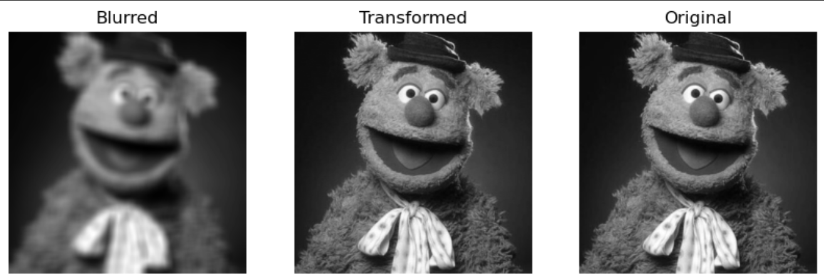
Method: Reduced QR Factorization

Slide 14

Method: Full QR Factorization

Slide 15

Method: Householder Reflectors
Because we again needed to iterate among the column vectors of the original image matrix to obtain our solution matrix, and the already existing nested loop in the Householder function, the final runtime for the Householder method was 162 minutes.

Slide 16
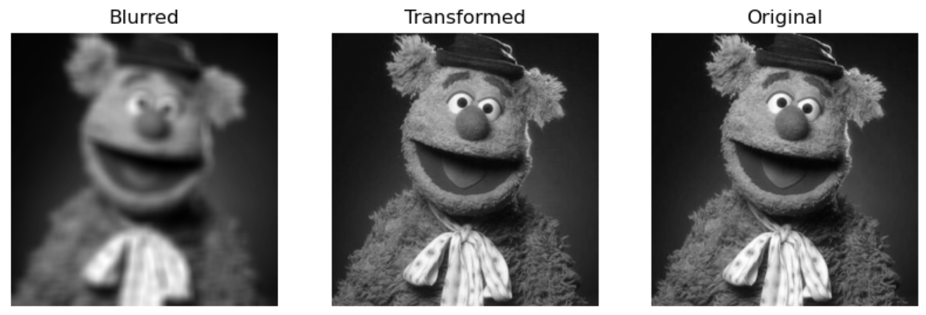
Method: Householder Reflectors
The resulting image is nearly identical to the original.

Slide 17
Takeaways
Numpy’s least squares function and the QR factorization proved to be the most efficient methods.
The Householder method proved to be very accurate but had an extensively long runtime.
The normal equation failed even with reduced blurriness, implying that the image matrix is ill-conditioned.

Slide 18
What next?
Single-valued decomposition (SVD)
Neural networks (NN)
Repeated QR and Householder Reflectors

Slide 19
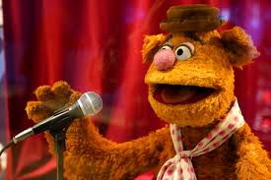
Thank you!

